Slide 1
Change in gene sequences over time
Learning objectives:
• understand the types of mutations that occur in organisms and variation in the rates of genome evolution
• understand how sequence divergence is measured
• understand sequence constraint variation between genes and how this can be measured

Slide 2
Lecture Overview
• mutation
• measuring sequence divergence
• the molecular clock
• codon usage
• rate variation among genes

Slide 3
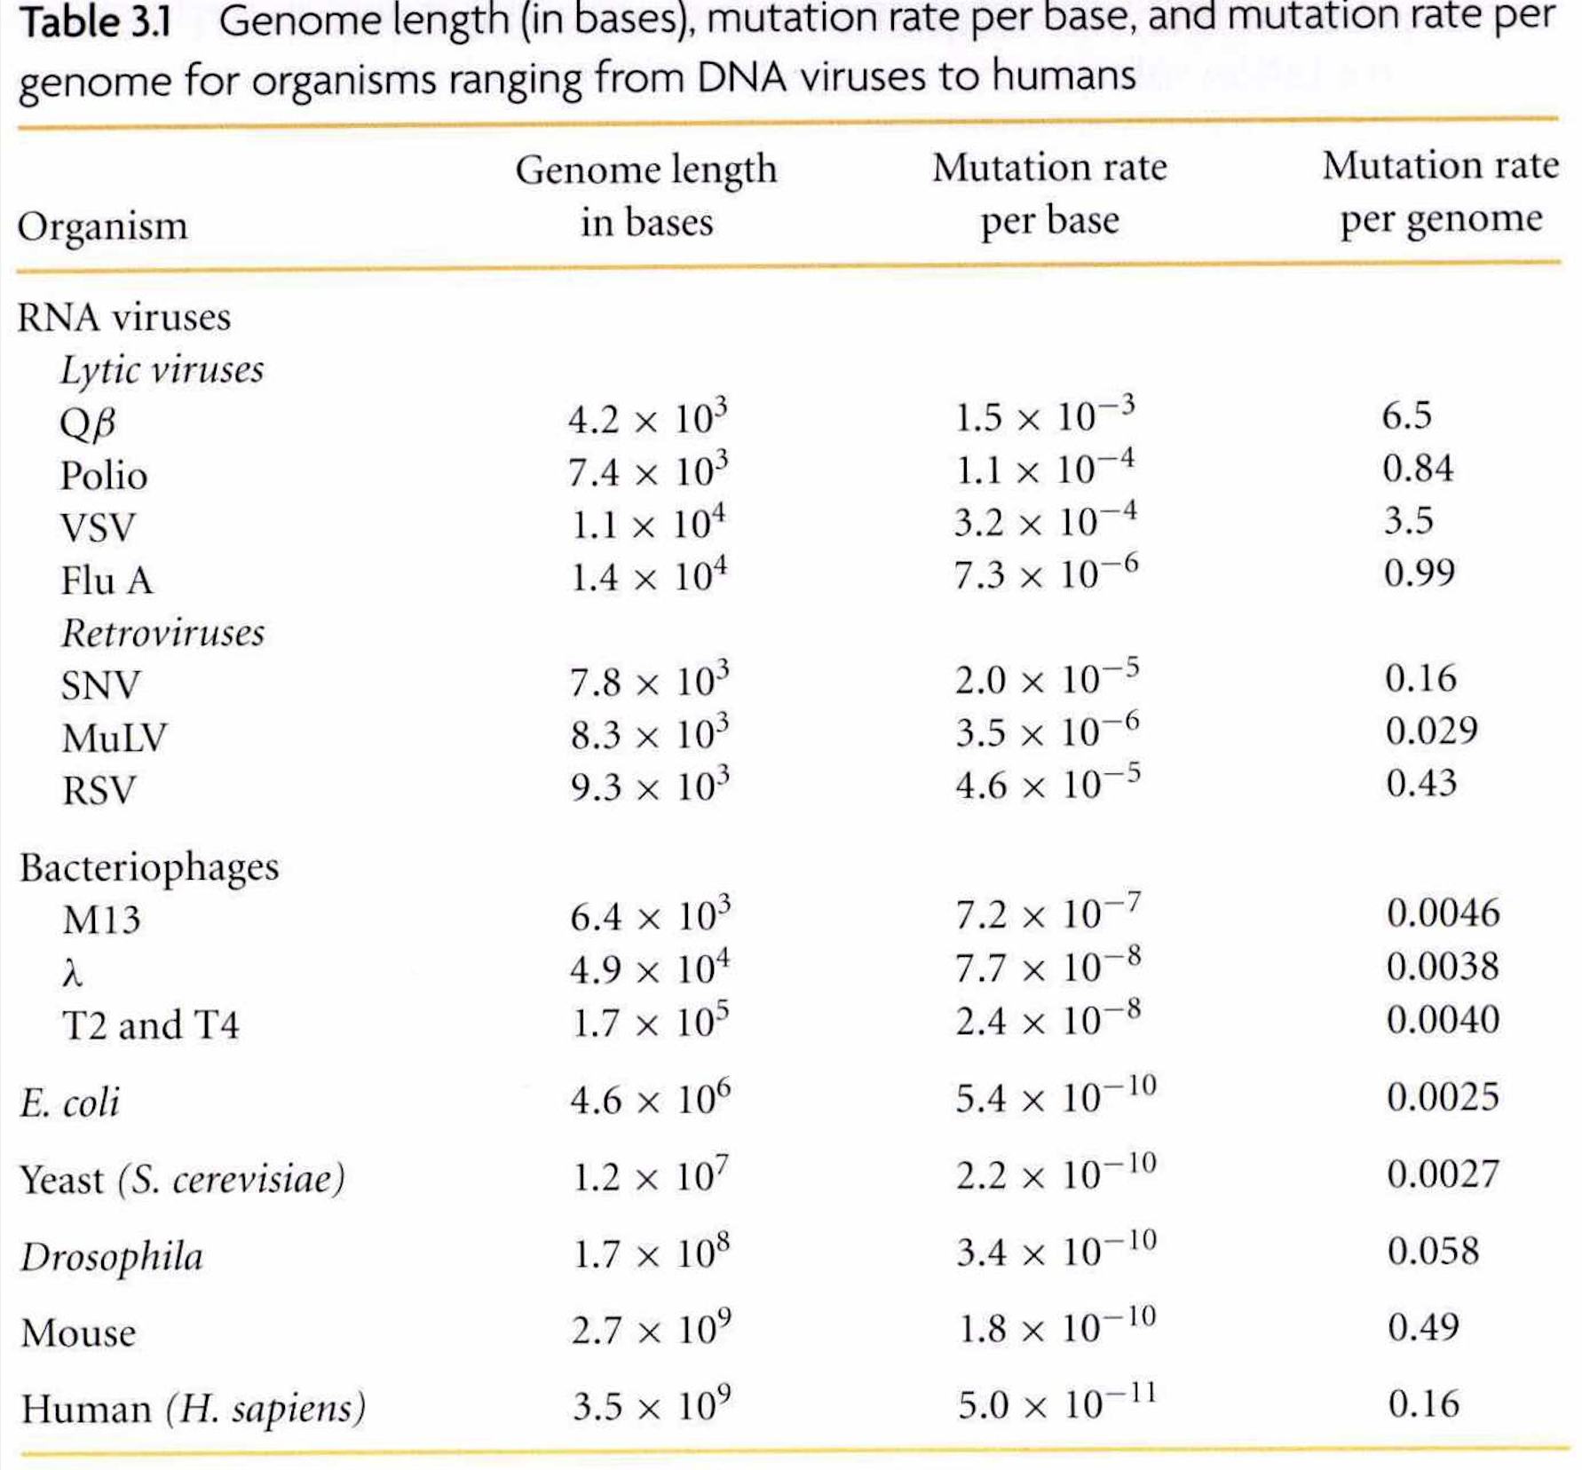
Mutation
• mutations in DNA sequences can be spontaneous via incorrect copying by polymerases
• what do you notice about the above table….?
Notes:
• nucleotide sequences undergo mutation chiefly as the result of misincorporation by polymerases
• they can also be influenced by metabolic rates and DNA damage
• some RNA viral polymerases have misincorporation levels as high as 1/1000bp (no proofreading activity)
• generally however mutation rates per generation are very low

Slide 4
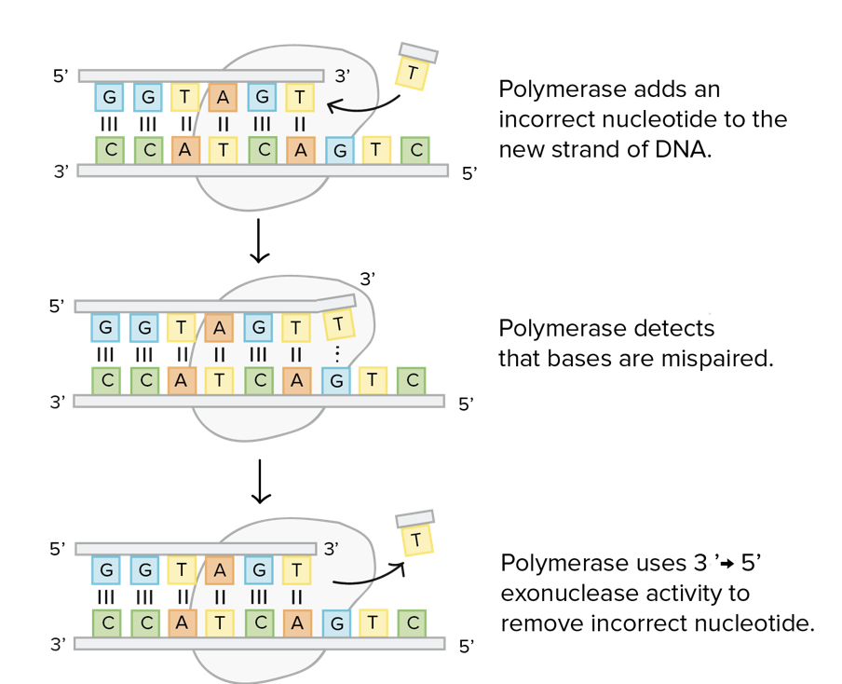
Reminder-DNA polymerases have proofreading activity
• repairing a point mutation

Slide 5
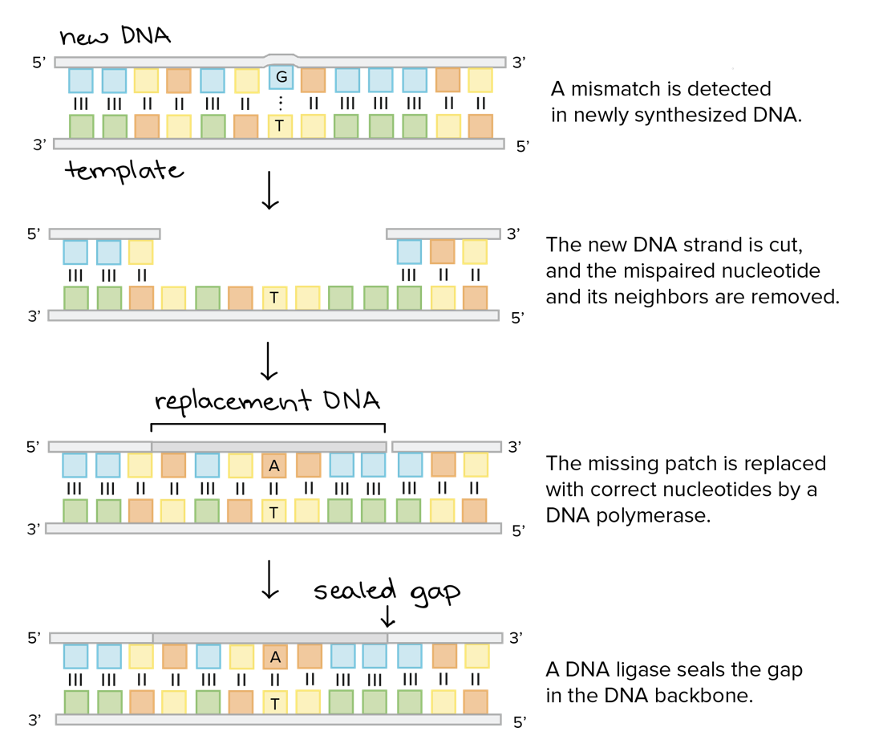
• repairing introduced point mutations
• repair machinery can be complex

Slide 6
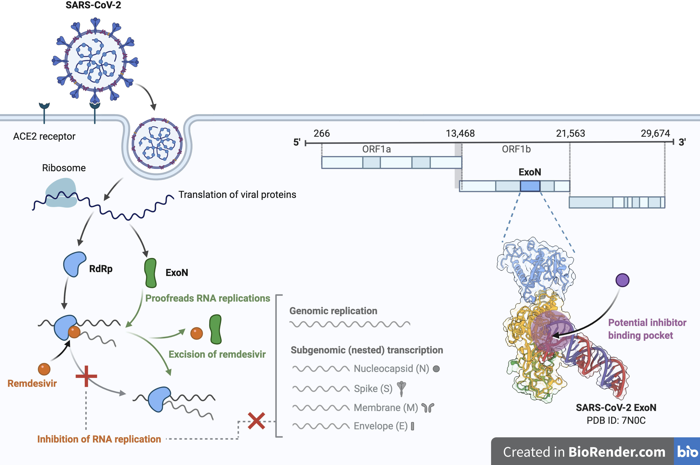
RNA polymerases lack proofreading activity
• except coronaviruses-which have the largest genomes of any RNA viruses as a result

Slide 7
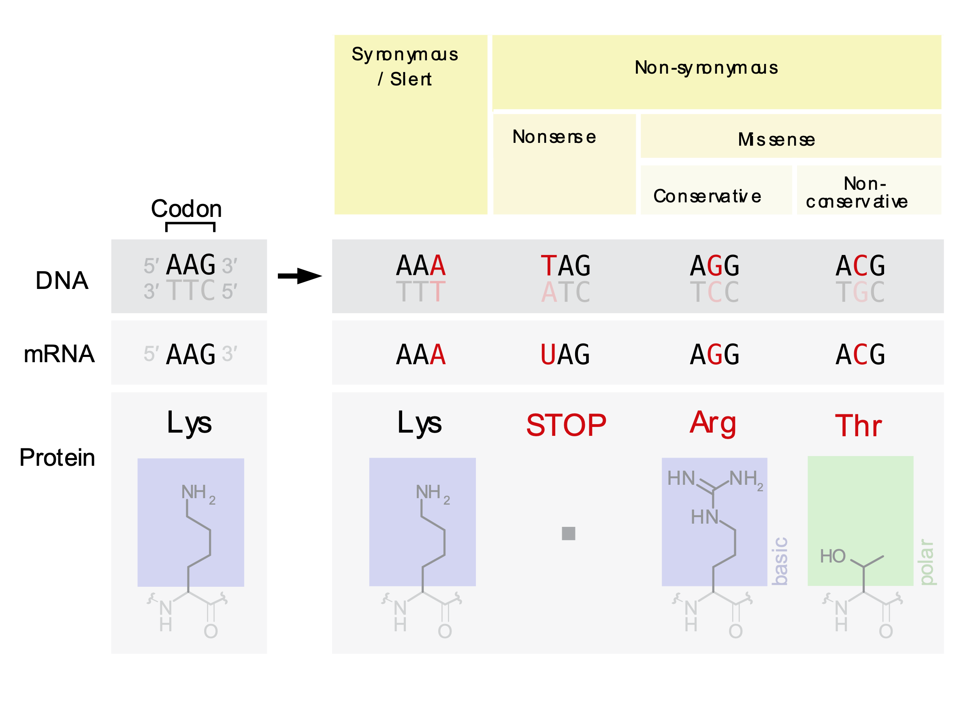
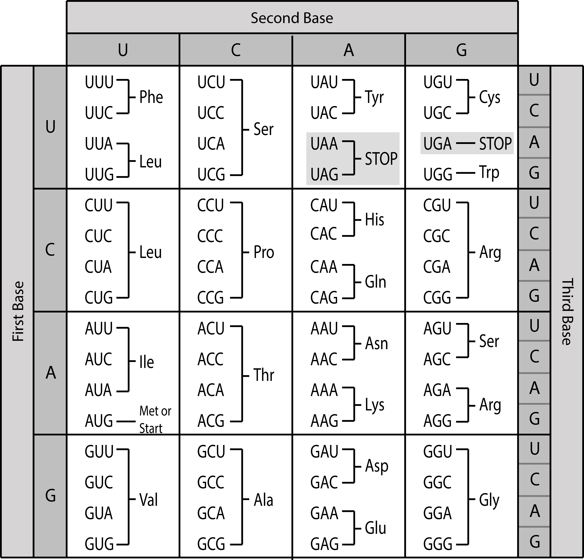
Classification of mutations
• a conservative mutation changes one amino acid to another one with similar properties

Slide 8
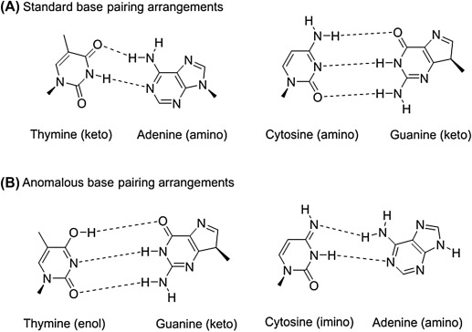
Spontaneous mutations
• can be the result of spontaneous
tautomerism
deamination
depurination
• keto/amino normal, enol/imino are rare forms that can lead to mispairing during replication or in already replicated DNA

Slide 9
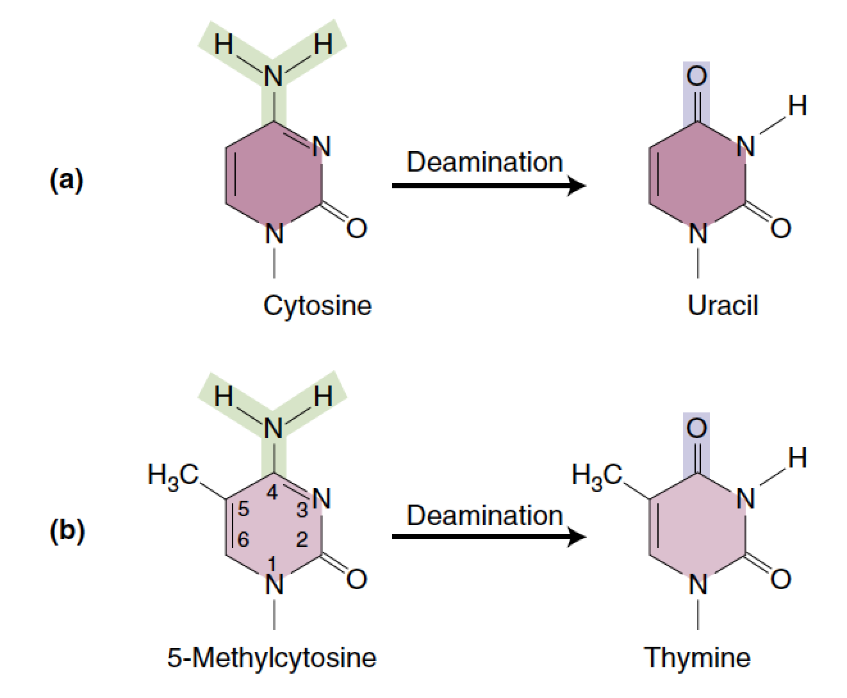
• spontaneous deamination of cytosine can lead to mutation of C:G to A:T after repair
• occurs more frequently at methylated DNA leading to CG mutation hotspots in DNA such as bacteria and humans

Slide 10
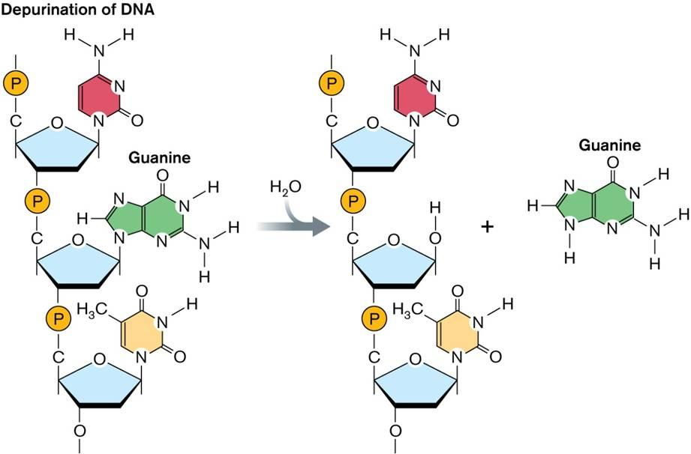
• spontaneous depurination
• can also result in a T:A bond after repair
• depurination rates can be 10s to 100s per hour in mammalian cells
• rates can be elevated by other factors such as UV or mutagens

Slide 11
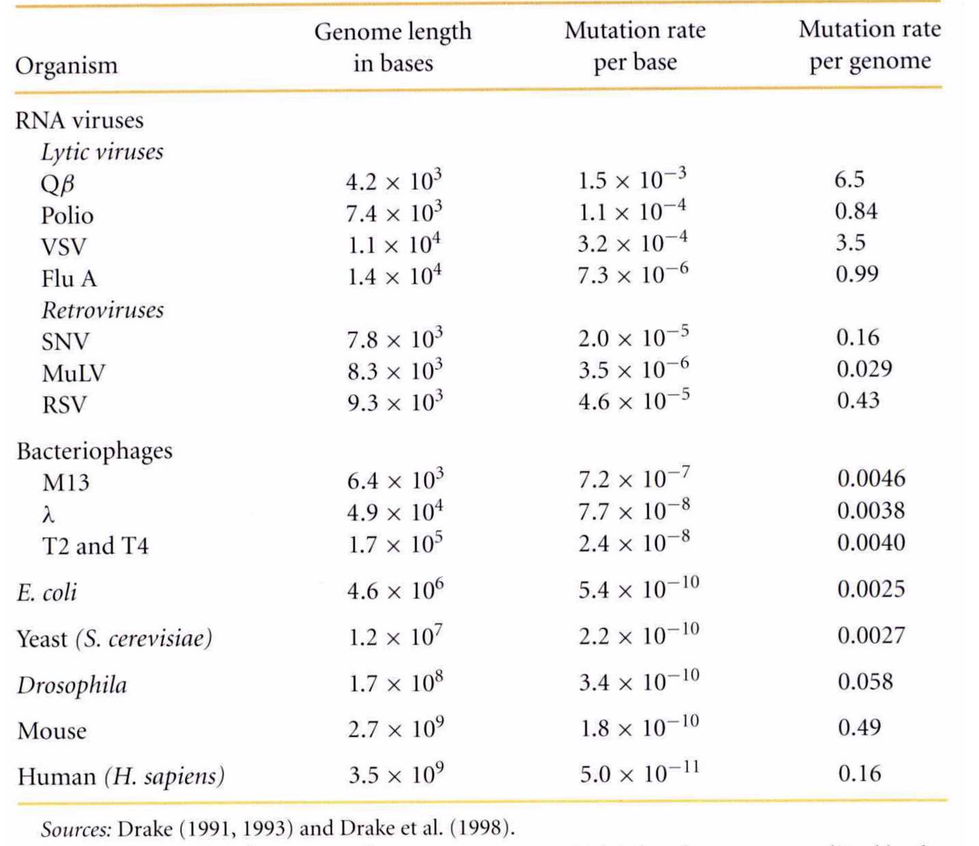
Change in nucleotide sequences
• mutation rates
Notes:
• nucleotide sequences undergo mutation chiefly as the result of misincorporation by polymerases
• they can also be influenced by metabolic rates and DNA damage
• some RNA viral polymerases have misincorporation levels as high as 1/1000bp (no proofreading activity)
• generally however mutation rates per generation are very low

Slide 12
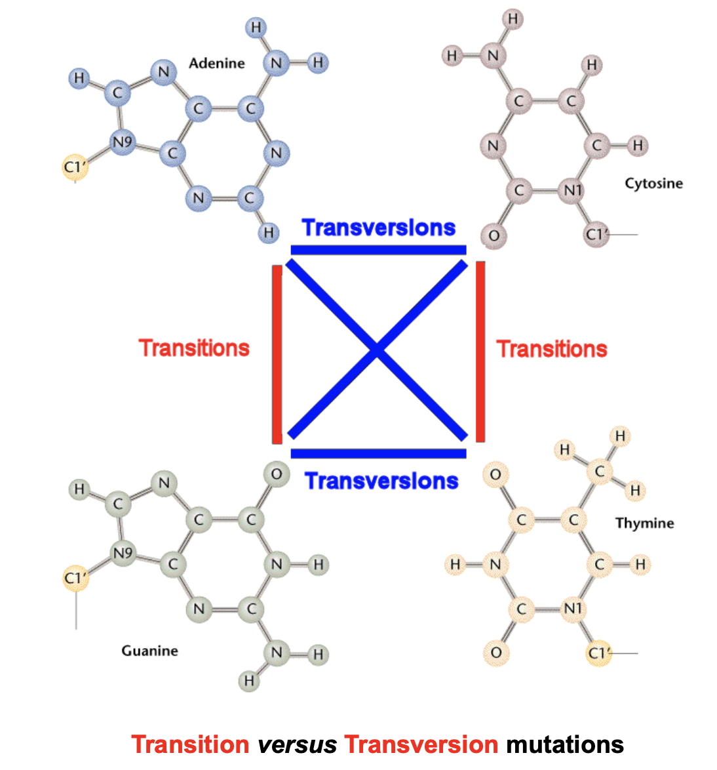
• types of mutation
Notes:
• point mutations can be divided into transitions (purine to purine, A-G) or pyrimidine to pyrimidine (C-T)
• all other mutations (eg C-G) are transversions)
• synonymous substitutions are silent, non-synonymous substitutions change the amino acid
• other changes involve insertions or deletions (see AF’s lectures for more details including mechanisms)

Slide 13
• transition versus transversion mutation rates
bovid COII gene divergence over time
Notes:
• in protein coding genes transitions evolve up to 10 fold faster than transversions
• thus transitions become ‘saturated’ before transversions

Slide 14
Measuring sequence divergence
Notes:
• often when looking at changes in gene sequences over time the actual number of changes is less than direct comparison of the sequences suggests
• this is due to multiple and other types of substitution
• this can have severe consequences when trying to understand dates of origin of genes or rates of evolution

Slide 15
• correcting for expected versus observed
sequence divergence
Notes:
• however, when sequence divergence between genes is low the actual number of substitutions is close to the observed number

Slide 16
• Jukes-Cantor: d(distance)=-3/4ln(1-4/3p)
where p is the proportion of nucleotide
differences
Notes:
• we can use the Jukes-Cantor 1 parameter model or the Kimura’s 2 parameter model (weights transitions and transversions differently)
• Jukes-Cantor: d(distance)=-3/4ln(1-4/3p) where p is the proportion of nucleotide differences
• Kimura: d=1/2ln(1-2P-Q)+1/4(1/[1-2Q]) where P and Q are proportional differences due to transitions and transversions respectively

Slide 17
The molecular clock
• some protein coding genes behave in a
clock-like manner (ie the rate if evolution
is the same in many different species)
Notes:
• differences can thus be used to estimate divergence times
Use molecular clocks for estimating divergence times at you peril though! I will explain why in the lecture.

Slide 18
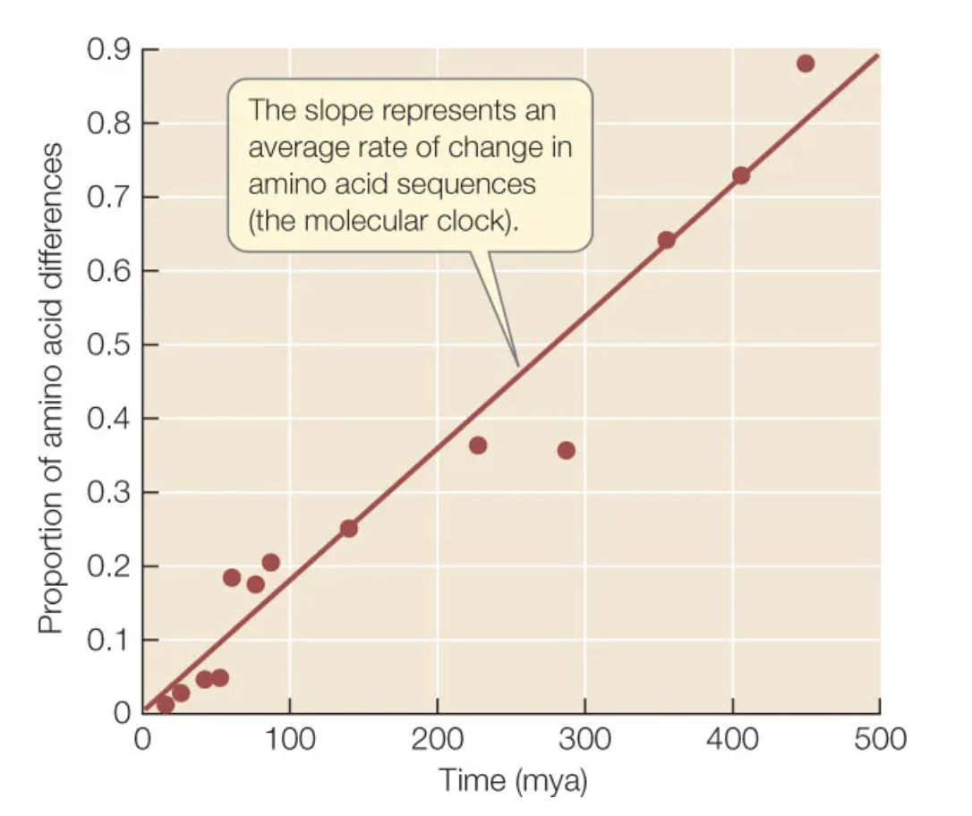
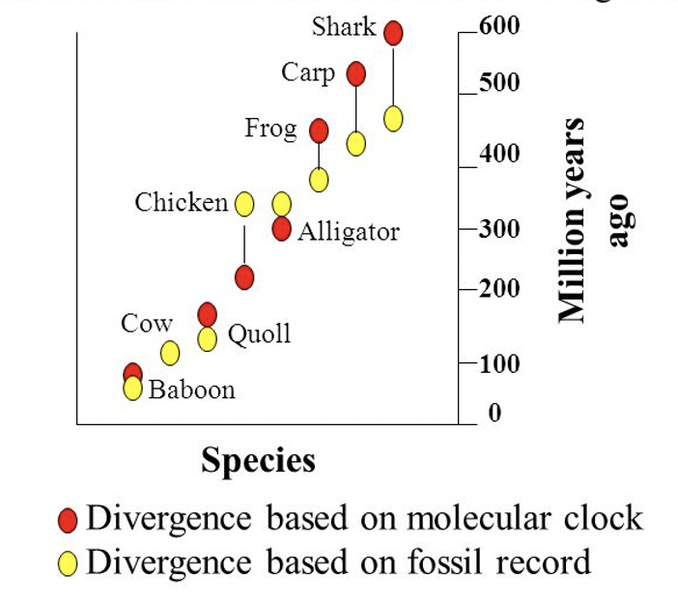
• divergence is constant through time-this is a human globin v different species
• thus, the rate of amino acid divergence in all species is constant and has been since divergence

Slide 19
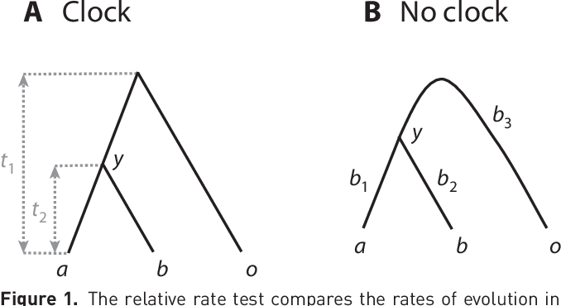
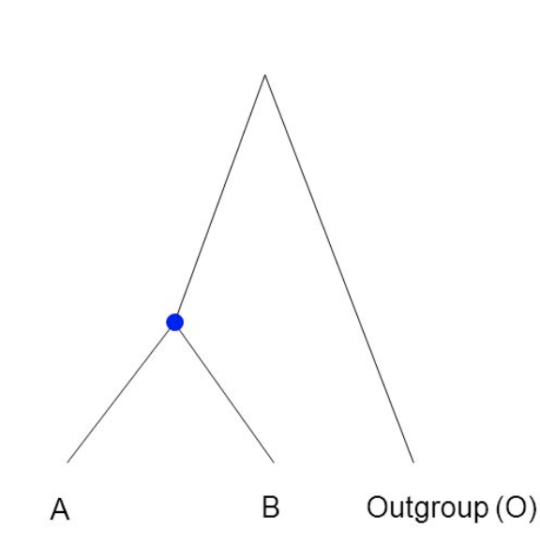
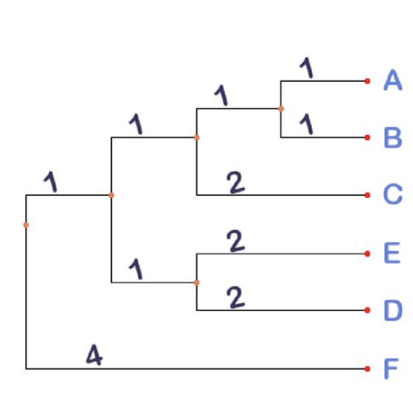
• =molecular clock when A-O=B-O
• can be investigated using a relative rate test
• a clock-like protein coding gene can be used to infer divergence dates across a whole phylogeny
• i.e. phylogenies can be calibrated-know one divergence date and you can estimate them all

Slide 20
• the rate is runs on absolute time and is
independent of generation time
Notes:
• thus most of the change occurring has been shifts between forms with equal adaptive ability. Probably because most mutation are deleterious to the protein

Slide 21
• silent substitutions do show a generation time
effect
• note these rates are per year
Notes:
• probably because most mutations are neutral

Slide 22
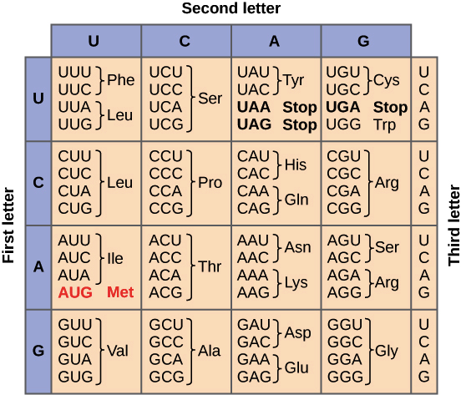
Codon usage
• although silent substitutions are generally neutral some codon choices are preferred=codon bias
Notes:
“regulates protein structure and gene expression through effects on co-translational protein folding, translation efficiency and accuracy, mRNA stability, and transcription. Codon usage regulates the speed of translation elongation, resulting in non-uniform ribosome decoding rates on mRNAs during translation that is adapted to co-translational protein folding process”
https://biosignaling.biomedcentral.com/articles/10.1186/s12964-020-00642-6

Slide 23
Rate variation among genes
• because of constraints some genes evolve
a lot faster than others
• this can be measured using dN/dS ratios
Notes:
• dN= number of non-synonymous changes per non-synonymous site
• dS= synonymous changes per synonymous site
• the lower the ratio the more constrained the gene
• when dN=dS there is no selection operating
What has been happening when the dN/dS ratio is greater than 1?

Slide 24
• dN/dS across primate, rodent and artiodactyl genes

Slide 25
• neutral versus deleterious mutations

Slide 26
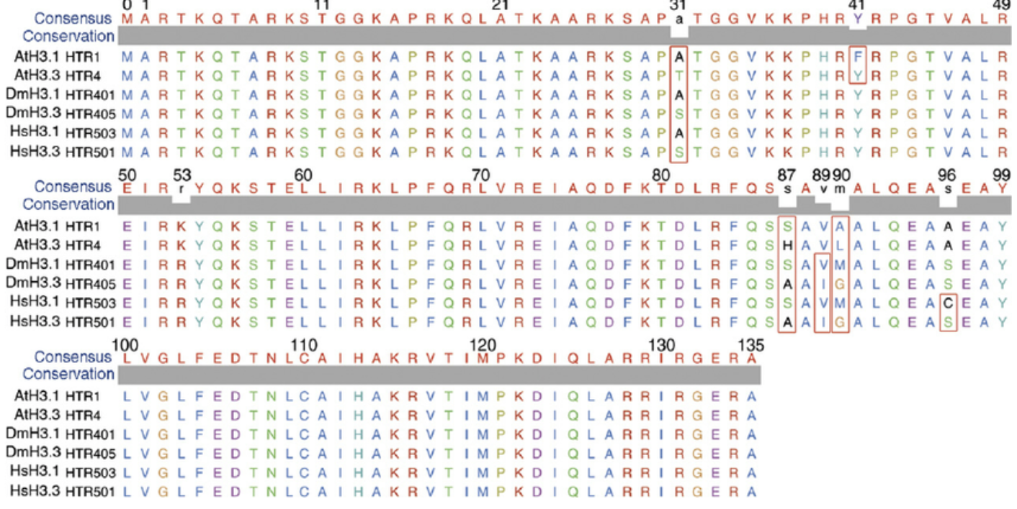
• Histone H3 sequences. At=plant (Arabidopsis), Dm=Drosophila, Hm-human. Amino acids are the same, as sequence constraint is very high, BUT nucleotide identity is much lower. Why is this? Discuss

Slide 27
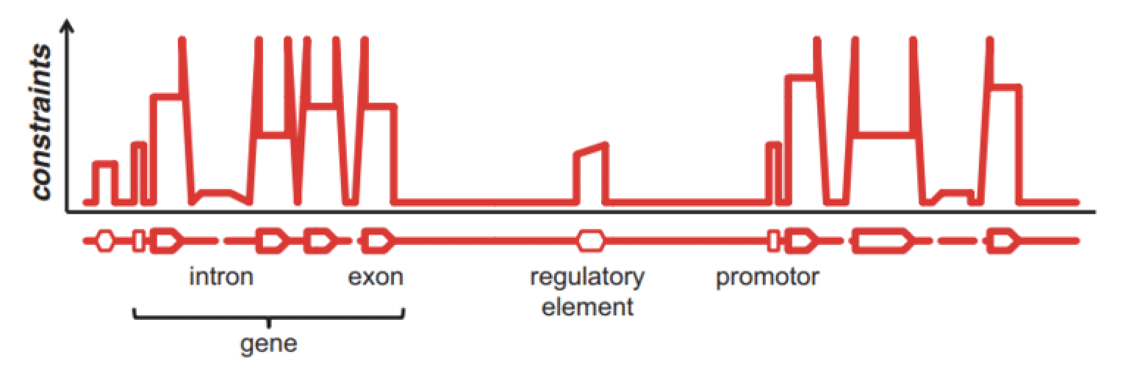
• constraints also operate in different regions
of a single gene

Slide 28
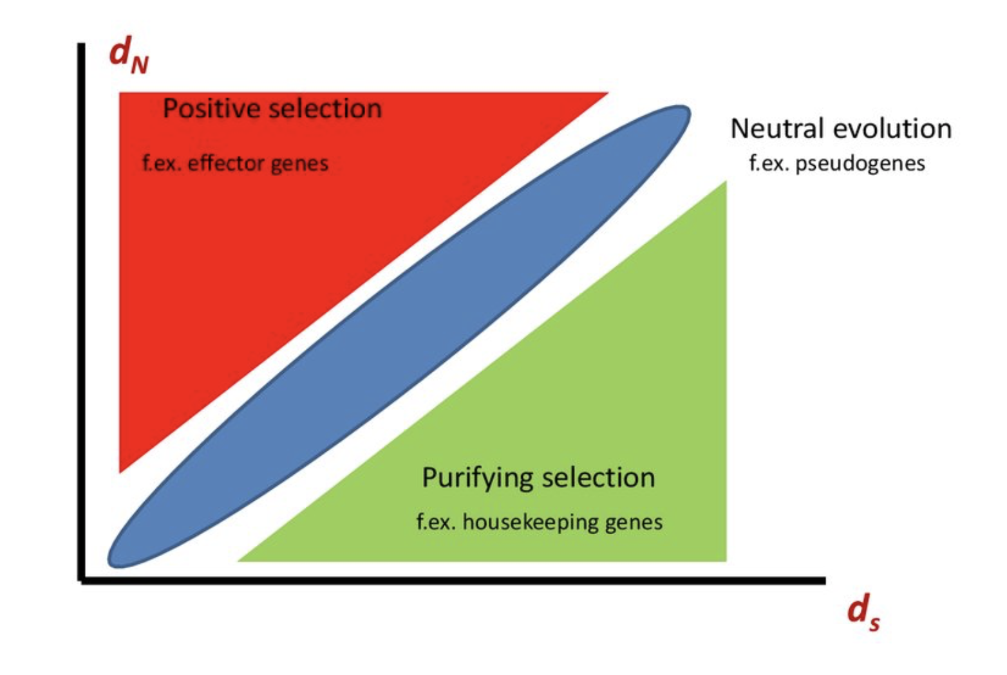
dN/dS ratios
• sequence constraints and selection can be measured using dN/dS ratios
• S=silent or synonymous substitution
• N=missense or non-synonymous substitution
Notes:
• dN= number of non-synonymous changes per non-synonymous site
• dS= synonymous changes per synonymous site
• the lower the ratio the more constrained the gene
• when dN=dS there is no selection operating
What has been happening when the dN/dS ratio is greater than 1?

Slide 29
• dN/dS across primate, rodent and artiodactyl genes
• these genes are under negative selection as they have a dN/dS of less than one
• effectively the encoded proteins towards the bottom of the figure can’t tolerate non-synonymous mutations in any position in their sequence (or very few at least) (thus dN/dS ratio of 0.1 or less)

Slide 30
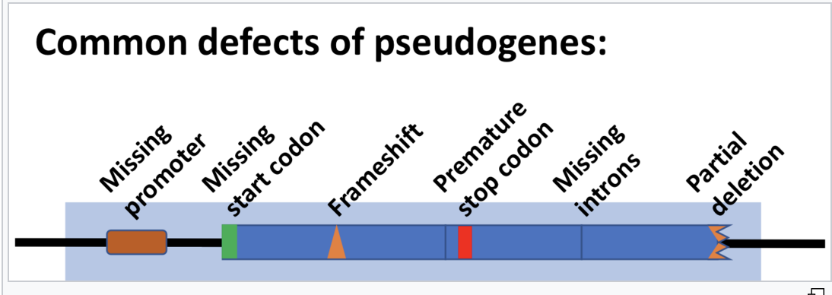
• pseudogenes look superficially like ‘real’ genes (their sequences can be aligned with ‘real’ genes)
• however, they have a dN/dS of 1 as they are not under selection=all mutations equally tolerated (the reasons for this are given in my ‘origin of new genes’ lectures)

